Slide 1
Herman
Nicolaas
Ridderbos
Notes:
One thing nice about going last is that I was able to learn about your theologians and how Ridderbos fit into the big picture. I also was able to get some good ideas. But most importantly, I was able to learn from your mistakes: (1) avoid information overload: don’t go too long and leave time for questions; and (2) use a really big font! ☺

Slide 2
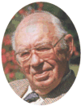
Herman Nicolaas Ridderbos
Redemptive-Historical
Theologian
(1909 - Present)
Notes:
That is probably the best way to summarize Ridderbos, so that is probably what you will want to know for the test Friday.

Slide 3
Handing Over of Volume 10
Notes:
The following three pictures were taken on Tuesday, May 23, 2000, at the dedication of volume 10 on Revelation of a commentary series produced by the Center for Biblical Research in Veenendaal.
It was handed over to Professor Dr. H. N. Ridderbos of Kampen. The presentation took place in the Christian College.
The Center for Biblical Research is dedicated to scientifically studying the Bible through the methods of biblical theology. They are convinced that the Bible is the inspired Word of God.
See http://www.studiebijbel.nl/

Slide 4
Dr. Ridderbos Speech
Notes:
Ridderbos is 91 in this picture.

Slide 5
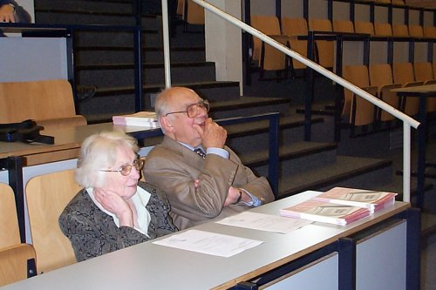
Dr. and Mrs. Ridderbos

Slide 6
The Editors
Notes:
These next several pictures were taken three years later on Tuesday February 4, 2003, at the dedication of Volume 1 of the New Testament commentary mentioned previously. This was the final volume covering introduction and synopsis, bringing the set to a close.
Ridderbos was among the editors for the series.
See http://www.studiebijbel.nl/fotosdeel1.htm

Slide 7
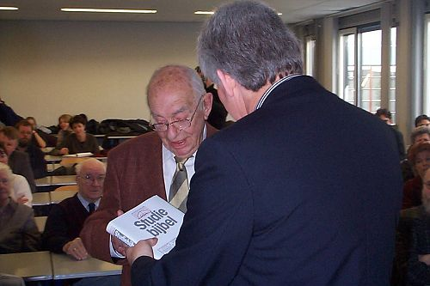
Handing Over of Volume 1
Notes:
The first copy was handed over to Dr. Ridderbos.

Slide 9
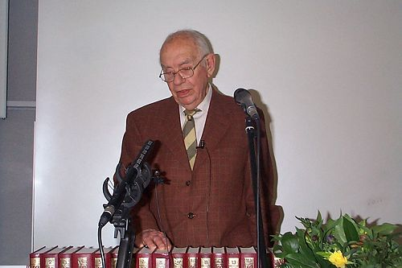
Dr. Ridderbos’s Speech
Notes:
Ridderbos was just a few days shy of 94 here.

Slide 11
Dr. & Mrs. Ridderbos

Slide 12
Dr. & Mrs. Ridderbos
Notes:
These pictures were taken on May 11, 2004, at the dedication of volume 1 of the study bible commentary series on the Old Testament (Genesis - Exodus). The first part of the tenfold study bible on the Old Testament has been completed.
Ridderbos is 95 years old here.

Slide 13
Sources
Roukema, Riemer. “Heilshistorische exegese. Herman Ridderbos.” in Profiel. Theologiebeoefening in Kampen 1970 – 1990, edited by J. van Gelderen and C. Houtman, 53-70. Kampen: Uitgeverij Kok, 2004.
“Herman Ridderbos’s Redemptive-historical Exegesis of the New Testament.” WTJ (2004).
Lane, William L. “Herman Ridderbos’ Paul: A Review Article.” JETS 22:4 (December 1979): 363-371.
Notes:
In addition to the handful of Ridderbos’s works that have been translated into English, there were few sources to make use of for information on his life and an evaluation of his theology and impact. I found the website of the seminary where Ridderbos taught—which, by the way, was all in Dutch—and emailed a few people. My email was forward to Dr. Riemer Roukema, Ridderbos’s third successor on the chair of NT at Kampen Theological University. He was very helpful in answering my questions and graciously gave me his article that he had recently written on Ridderbos. It was published originally in Dutch in a book put out for the 150th anniversary of Kampen. He informed me that it would be coming out in WTJ later this year.
Lane’s article was also of some help.

Slide 14
Overview
His Life
His Writings
His Theology
His Influence
An Evaluation

Slide 15
His Life

Slide 16
Family
His Father
Jan Ridderbos (1879-1960)
Professor of OT at Kampen Theological Seminary from 1913-50.
He wrote:
Deuteronomy, Zondervan, 1984.
Isaiah, Regency, 1985.
Notes:
I start with his family because it helps to see the kind of upbringing that Ridderbos had.
This picture of some of the faculty at Kampen was taken in 1929.
“A conservative, evangelical, Dutch Reformed commentary on Deuteronomy that is highly regarded for the outstanding quality of its biblical exegesis & exposition. Unfailingly helpful & rich in insights into the text. A monument to devout Continental biblical scholarship. Out of print. Highly recommended.”

Slide 17
Family
His Brother
N. H. Ridderbos
Nicolaas Herman Ridderbos
Professor of OT at the Free University of Amsterdam
He wrote Is There a Conflict Between Genesis 1 and Natural Science?, Eerdmans, 1957.
Notes:
You may be thinking that his initials look strangely similar to his brother Herman’s. H. N. Ridderbos and N. H. Ridderbos, well, you guessed it. His name is Nicolaas Herman Ridderbos. Creative parents.
N. H. Ridderbos holds to the framework hypothesis.
“The Framework Hypothesis was first proposed by Dr. Noordzij of the University of Utrecht in the Netherlands in the early 1950’s. His defense of the Framework Hypothesis never became very popular. The later popularity of the view could be explained by the fact that the idea was picked up by Dr. N. H. Ridderbos, a prominent figure in the Gereformeerde Kerken in the Netherlands. He wrote a book in which he spelled out his view of the Framework Hypothesis and defended it. The title of the book is, Is There A Conflict Between Genesis 1 and Natural Science? That book has been translated and is available in this country, though only as a used book. But even that book did not really make much progress within Reformed and Presbyterian circles until this same view was picked up by theologian and Old Testament scholar Meredith Kline. He has popularized the theory.”
“Even Herman [should be N. H., not Herman] Ridderbos, who promoted the Framework Hypothesis, wrote concerning the creation narrative in his book on the subject: ‘One who reads Genesis 1 without prepossession or suspicion is almost bound to receive the impression that the author’s intent is to say that creation took place in six ordinary days.’”

Slide 18
Birth
Born on February 13, 1909 in Oosterend (Friesland), the Netherlands.
He grew up in the Reformed Church and in a strong, conservative Christian home.
Notes:
The Netherlands Reformed Church (NRC): This group was the original group.
The Reformed Churches in the Netherlands (RCN): This group, of which Ridderbos was a part, split off from the previous group in 1834. I’m not sure of the reasons for the split.
It’s interesting, though, that the three main Protestant groups are hoping to be united into one by the end of this year.

Slide 19
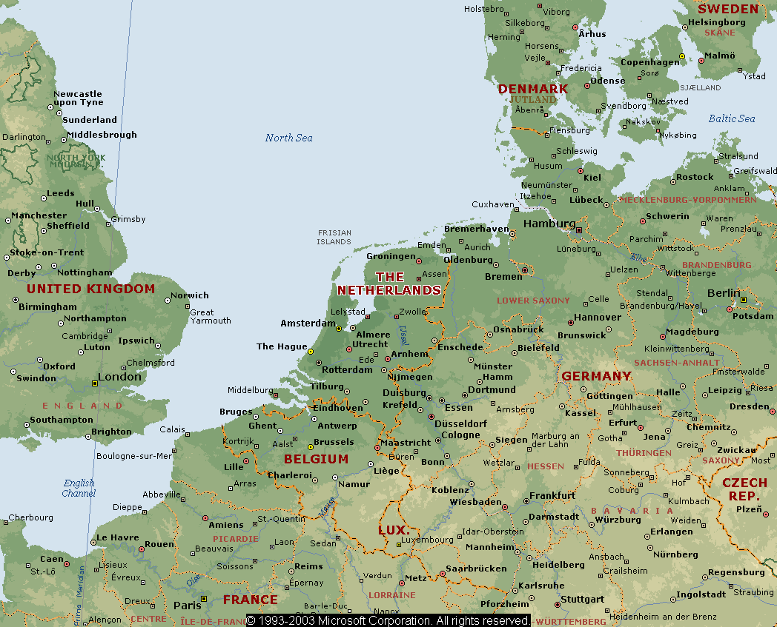

Slide 20
Oosterend

Slide 21
Education and Ministry
Received his undergraduate degree from Kampen.
In 1934, at age 25, he became the minister of the Reformed Church in Eefde-Gorssel.
On November 13, 1936, at age 27, he obtained his doctorate with distinction at the Free University at Amsterdam under Professor Frederik Willem Grosheide.
In 1939 he became the minister in Rotterdam-Charlois, where he ministered until 1942.
Notes:
His dissertation was on the Sermon on the Mount.
While Ridderbos was a scholar, he seems to have some pastoral concern in much of his writings. I will send you a sermon of Ridderbos’s that will show how his redemptive-historical theology manifested itself in His preaching.

Slide 22
Teaching Career
On January 21, 1943, he succeeded Seakle Greijdanus as New Testament professor at Kampen Theological Seminary.
He held this position for 35 years, retiring in 1975 and stepping down from his chair in 1978.
Notes:
It was during this time that he did the bulk of his writing.

Slide 24
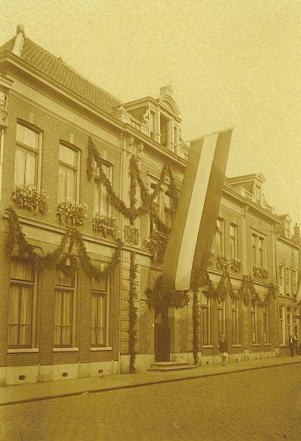
Kampen Theological University
Founded in 1854 by the churches of the Secession, local churches that had separated themselves from the Dutch Reformed Church in 1834.
Notes:
The Theological University of Kampen (ThUK) is rooted in the European Reformed tradition. With this in mind, it participates in an ongoing dialogue between the various world religions and other fundamental life options and in the interaction between faith and culture. It offers an internationally and ecumenically orientated program of theological study with explicit attention being paid to intercultural questions.

Slide 25
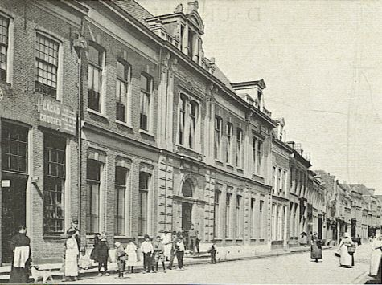
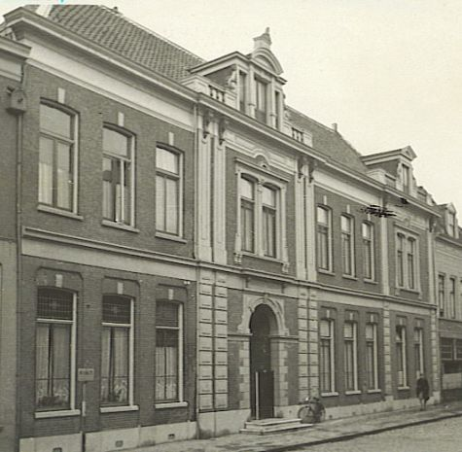
Kampen Theological University
A significant number of influential theologians graduated from Kampen Theological University, perhaps the most well-known being Dr. Herman Bavinck (1854-1921).

Slide 26
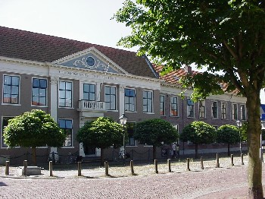
Kampen Theological University
2004 is the 150th anniversary of both Kampen Theological University and of the theologian Herman Bavinck (1854-1921).
Notes:
This year ThUK will celebrate its 150th anniversary, the three Reformed Churches of the Netherlands - the Netherlands Reformed Church (NRC), the Reformed Churches in the Netherlands (RCN), and the Evangelical Lutheran Church in the Kingdom of the Netherlands (ELC) - will unite themselves as the Protestant Church in the Netherlands (PKN).
To commemorate these facts Kampen Theological University – in cooperation with the Historical Documentation Center for Dutch Protestantism and the Theological Faculty of the 'Vrije Universiteit' , Amsterdam – will hold a three-day congress on 28, 29 and 30 October 2004 entitled: Enounters with Bavinck
Today Kampen Theological University is one of the three theological training centres of the Uniting Protestant Churches in the Netherlands, which are expected to unite into the Protestant Church in the Netherlands in 2004.
2004 is the sesquicentennial of Kampen Theological University and of the theologian Herman Bavinck (1854-1921). To commemorate these facts Kampen Theological University – in cooperation with the Historical Documentation Center for Dutch Protestantism and the Theological Faculty of the 'Vrije Universiteit' , Amsterdam – will hold a three-day congress on 28, 29 and 30 October 2004 entitled: Encounters with Bavinck. The symposium will be led by Prof. Dr. G.W. Neven (Kampen) and Prof. Dr. G. Harinck (Amsterdam) and a small team of enthusiastic Bavinck researchers of other theological institutions, Drs. J.M. Burger (Kampen Theological University (Broederweg)), Dr. D. van Keulen (Vrije Universiteit), and Drs. W.J. de Wit (Vrije Universiteit). The central focus of the congress is the continuing fascination for Bavinck. Attention will be paid to different aspects of his life, his career and his works. He was not only one of the important dogmaticians in the modern history of Dutch theology, but also an author of philosophical and pedagogical works, an influential politician, a famous popular writer, and together with Abraham Kuyper leader of the neocalvinistic movement.
Scholars have been invited to deliver a contribution describing their encounters with Bavinck. Which elements in Bavinck's theology must not be forgotten? They will share their fascination with us at this congress. The theological contributions at the conference will deal with the way in which Bavinck gives expression to the presence of God. In dealing with this theme, Bavinck seems to transcend the limits of his systematic way of working. Themes are: the presence of the Word and the internal testimony of the Spirit, the (sacramental) presence of Jesus Christ in the unio mystica, the nearness of faith and thinking to the mystery of God, the nearness of grace to nature and its implications for e.g. thinking on the relation between creation and evolution. Other themes that will be dealt with are: Bavinck on the feminist movement, Bavinck’s political views, Bavinck’s experiences in the United States, Bavinck and the Roman-Chatholic Church, Bavinck and the Islam.

Slide 27
Dr. Herman Bavinck (1854-1921)
Studied theology in Leiden and Kampen.
In 1882 was appointed as Kampen’s Professor of Dogmatics.
Wrote his Reformed Dogmatics.
In 1902 began teaching at the Free University in Amsterdam.
Notes:
The ThUK is rooted in the European Reformed tradition. With this in mind, it participates in an ongoing dialogue between the various world religions and other fundamental life options and in the interaction between faith and culture. It offers an internationally and ecumenically orientated programme of theological study with explicit attention being paid to intercultural questions.
Today Kampen Theological University is one of the three theological training centres of the Uniting Protestant Churches in the Netherlands, which are expected to unite into the Protestant Church in the Netherlands in 2004.
2004 is the sesquicentennial of Kampen Theological University and of the theologian Herman Bavinck (1854-1921).
To commemorate these facts Kampen Theological University – in cooperation with the Historical Documentation Center for Dutch Protestantism and the Theological Faculty of the 'Vrije Universiteit' , Amsterdam – will hold a three-day congress on 28, 29 and 30 October 2004 entitled: Encounters with Bavinck.

Slide 28
Seminary Faculty in 1950
Herman Ridderbos
J. H. Bavinck
Jan Ridderbos
Notes:
Johan Herman Bavinck: Rotterdam, 22-11-1895 - † Amsterdam, 23-6-1964.
I assume that this was Bavinck’s son, but I‘m not sure.

Slide 29
Still Living
“Herman Ridderbos is alive and in a fairly good health for his 95 years, although it is more difficult than some years ago to have a serious conversation with him about the past and present developments in church and society” (Personal Correspondence with Dr. Riemer Roukema, 10/08/2004).

Slide 30
His Writings

Slide 31
Three Main Stages of Writing
1936-1952: The Synoptics
1952-1967: Paul
1966-1987: John
Notes:
If you would like, I have a word document with all his writings that I was able to identify, as well as some Dutch sources that give a more exhaustive discussion.

Slide 32
Synoptics
De strekking der Bergrede naar Mattheüs [The Tenor of the Sermon on the Mount according to Matthew], 1936.
Het Evangelie naar Mattheüs I [The Gospel to Matthew I], 1941.
Het Evangelie naar Mattheüs II [The Gospel to Matthew II], 1946.
Notes:
All of his writings were published by Kampen unless otherwise noted.
This was his PhD dissertation. This work “demonstrated that [he] was a skilful exegete” (Roukema).
A synopsis is available in When the Time Had Fully Come, 26-43.

Slide 33
Synoptics
Zelfopenbaring en zelfverberging. Het historisch karakter van Jezus’ messiaansche zelfopenbaring volgens de synoptische evangeliën . [Self-revelation and Self-concealment: The Historical Character of Jesus’ Messianic Self-revelation according to the Synoptic Gospels], 1946.

Slide 34
Synoptics
De komst van het Koninkrijk. Jezus’ prediking volgens de synoptische evangeliën, 1950.
*The Coming of the Kingdom, P&R, 1962 [1969]. 556 pp.
At this point, this was his most important work.
Notes:
All *starred books are available in English—some new, some used.

Slide 35
Transition
Paulus en Jezus. Oorsprong en algemeen karakter van Paulus’ Christus-prediking, 1952.
*Paul and Jesus: Origin and General Character of Paul’s Preaching of Christ, 1958. 155 pp.
Notes:
Paul and Jesus was the book that transitioned his study of the Synoptic Gospels to a study of Paul.
He combats the notion that there is a dichotomy between Jesus and Paul, between the Jesus of history and the Christ of faith, arguing that they preached the same message, the kingdom of God inaugurated in the death and resurrection of Christ.

Slide 36
Paul
*The Epistle of Paul to the Churches of Galatia, NICNT, 1953. 238 pp.
“Israël in het Nieuwe Testament, in het bijzonder volgens Rom. 9-11” [“Israel in the New Testament, especially according to Rom. 9-11”], Van Keulen, 1955.

Slide 37
Scripture
Heilsgeschiedenis en Heilige Schrift van het Nieuwe Testament. Het gezag van het Nieuwe Testament, 1955.
*The Authority of the New Testament Scriptures, P&R, 1963. 93 pp.
*Redemptive History and the New Testament Scriptures, 1968; 2nd Rev. ed., 1988. 91 pp.
Notes:
In this work, Ridderbos challenges the normal way of defending the canon. We’ll look at it in more detail later.

Slide 38
Summary Work
When the Time Had Fully Come: Studies in New Testament Theology, Eerdmans, 1957. 104 pp.
Notes:
This work was produced just for the English speaking world.
It is a summary of his redemptive-historical approach to the New Testament.
This is probably the best place to start if you want to study Ridderbos.

Slide 39
Synoptics
Het verborgen Koninkrijk. Handleiding tot het Evangelie van Mattheüs, 1958.
*Matthew’s Witness to Jesus Christ: The King and the Kingdom. Lutterworth Press, 1958.
Notes:
While he did still write and publish material on the synoptics, it was not really his focus.

Slide 40
Paul & Others
Aan de Romeinen. Commentaar op het Nieuwe Testament [To the Romans], 1959.
*Bultmann, P&R, 1960. 46 pp.
Aan de Efeziërs. Aan de Colossenzen. Commentaar op het Nieuwe Testament. [To the Ephesians. To the Colossians.], 1960.
*The Speeches of Peter in the Acts of the Apostles. Tyndale, 1962 [1977]. 31 pp.
Notes:
The part on Ephesians was authored by F. W. Grosheide, the professor under whom he studied at the Free University of Amsterdam.

Slide 41
John
“Opbouw en strekking van de proloog van het evangelie van Johannes.” [“The Structure and Scope of the Prologue to the Gospel of John”] Novum Testamentum 8 (1966): 180-201.
Notes:
This began his interest in John’s gospel, on which he would later write an excellent commentary.

Slide 42
Paul
Paulus. Ontwerp van zijn theologie, 1966. 653 pp.
*Paul: An Outline of His Theology, 1975, [1997]. 587 pp.
This is his magnum opus.
De Pastorale brieven. Commentaar op het Nieuwe Testament [The Pastoral Epistles], 1967.

Slide 43
Scripture & John
*Studies in Scripture and Its Authority, Eerdmans, 1978. 109 pp.
Het Woord is vlees geworden. Beschouwingen over het eigen karakter van het Evangelie van Johannes [The Word Became Flesh: Reflections on the Unique Character of the Gospel of John], 1979.

Slide 44
John
Het Evangelie naar Johannes. Proeve van een theologische exegese I-II, 1987, 1992.
*The Gospel of John: A Theological Commentary, Eerdmans, 1997. 721 pp.

Slide 45
Other Writings
In addition to these, Ridderbos wrote approximately 1750 articles in Gereformeerd Weekblad (“Reformed Weekly”) between 1945 and 1982.

Slide 46
Most Important
Paul: An Outline of His Theology
The Coming of the Kingdom
Notes:
His commentary on John and his work on the canon are also significant.

Slide 47
His Theology
Redemptive History

Slide 48
His Theology
Redemptive History
Paul’s Theology
The Kingdom
The Scriptures
Notes:
Ridderbos never wrote an NTT, yet his contribution to the field of NT studies is unquestionably significant.
These points reflect his most important works:
For a summary of his redemptive historical approach, read When the Time Had Fully Come: Studies in New Testament Theology. Here he applies his redemptive-historical approach to the synoptics, especially the kingdom, to the authority and canonicity of the Scriptures, and to Paul’s theology.
For a fuller treatment of the Kingdom see The Coming of the Kingdom.
For a fuller treatment of the Scriptures see Redemptive History and the New Testament Scriptures.
For a fuller treatment of Paul’s Theology see Paul: An Outline of His Theology.

Slide 49
Redemptive History
What is Redemptive History?
“A Redemptive-Historical Consideration of Philemon,” Kerux 12.1 (May 1997): 23-32.
Dan Olinger

Slide 50
Redemptive History
What is Redemptive History?
Heilsgeschichte or heilsgeschichtlich (redemptive-historical)
Biblical theological approach to the Scriptures
Revelation in both history and word
Redemption as the theme of human history
The death and resurrection of Christ - the transition point from the old age to the new
Notes:
Redemptive history is a subcategory of BT.
Herman Ridderbos stated in 1994 that what is now called Biblical theology was then called historia revelationis.
“In the crucified and risen Savior the great turning-point in God’s times has come” (48).

Slide 51
Summary Statement
“The real nature of Paul’s preaching of Christ . . . [is] redemptive-historical, eschatological [in its] content. It is decisively defined by what has taken place in Christ, by the acts of God that he wrought in him for the fulfillment of his redemptive plan and of which the death and resurrection of Christ constitute the all-controlling center” (Paul, 50).
Notes:
“The real subject of Paul’s preaching was, as I have pointed out before, the announcement of the new times in Jesus Christ, the revelation of what was hidden. This is the same as what in the Gospels is called the coming of the Kingdom. As a matter of fact, the epistles of Paul are in the wider sense of the word, kerygma, eugangelion, of and about Jesus Christ, proclamation of what God did when the time had fully come. . . . Nevertheless, the modality of Paul’s kerygma is different from that of the Gospels. We can characterize it as the explanation of the history of salvation which is recorded for us in the Gospels. For that reason Paul’s epistles, and the great part of the remaining books of the New Testament, have rather the character of teaching . . . . The contents of the kerygma and the didache in the New Testament are exactly the same, but the modality is different. What is proclaimed by the herald is explained by the teacher” (94).
“Paul’s epistles . . . teach us many things but always teach us from one central point, namely, from the cross and the resurrection of Christ. . . . Their revelatory character consists in the fact that they place all things in the light of the great works of God in His Son Jesus Christ” (95).
“Its [the New Testament’s] real content is the coming of the Kingdom, the coming of the great time of salvation. Its content consists of the great acts of God in His Son Jesus Christ. Therefore the essential nature of the New Testament Scriptures is first and foremost that of a proclamation” (90).

Slide 52
Pauline Theology
What was the center of Paul’s theology?
Justification
The Spirit
Redemptive History
Notes:
“From what point of view can Paul’s preaching be approached most adequately? The entrance to this imposing edifice is our concern” (WTHFC, 44).
“Reformation theology . . . found this main entrance in Paul’s preaching of justification” (44).
To Luther, Paul’s doctrine of justification by faith in fact became the principium and criterium for his evaluation of the whole New Testament. . . . This furnished the key to understanding the whole of Paul” (44-45).
“In Calvin and in the tradition proceeding form him these matters are probably more balanced. All the same, here, too, justification by faith remains the main entrance” (45).
Another idea emerged, “the mystical idea of the Pneuma, the being-in-Christ” (45). He mentions Ludemann and Holsten. Paul statements on the Spirit were central, no longer was Romans 3-5 and Galatians 3-4 the center, but Romans 6-8 and Galatians 5.
“The term ‘redemptive-historical’ (translation of the German expression: Heilsgeschichtlich) expresses a new and broader outlook on the general character of Paul’s preaching. The question is, however, what is meant by it, and in what way this new approach can offer us any deeper understanding of the inner relationships of Paul’s preaching, as well as of the unity between the kerygma of Paul and that of Christ” (47).

Slide 53
Key Elements
Two Ages:
The Old Age and the New Age
The Old Man and the New Man
The Flesh and the Spirit
Notes:
As distinct from the older covenant theologians who saw a unity of the covenant of grace between both testaments, Ridderbos is more akin to New Covenant theology, drawing a sharp dichotomy between the Old Age and the New. He is definitely not a dispensationalist, but discontinuity seems to be a central element to his thought. He does regard church to be a replacement of Israel as the people of God. He is certainly not a premillennialist, seeing no future for Israel as a nation beyond this age when the all Israel is currently being saved.

Slide 54
Old Age and New Age
“Christ and Adam stand over against one another as the great representatives of the two aeons, that of life and that of death. In that sense, as representing a whole dispensation, a whole humanity, Adam can be called the type of him who was to come, i.e., of the second man and of the coming aeon represented by him. For as the proto-father brought sin and death into the world, so Christ by his obedience (that is, by his death) and resurrection has made life to dawn for the new humanity” (Paul, 57).

Slide 55
Old Man and New Man
“Frequently the old man is taken in an individual sense and the crucifying and putting off of the old man as the personal breaking with and fighting against the power of sin. ‘Old’ and ‘New’ then designate the time before and after conversion or personal regeneration, and the corresponding manner of life” (Paul, 63).

Slide 56
Old Man and New Man
“But we shall have to understand ‘old’ and ‘new man,’ not in the first place in the sense of the ordo salutis, but in that of the history of redemption [historia salutis]; that is to say, it is a matter here not of a change that comes about in the way of faith and conversion in the life of the individual Christian, but of that which once took place in Christ and in which his people had part in him in the corporate sense” (Paul, 63).
Notes:
He continues: “Undoubtedly there is also mention of the putting off of the old and the putting on of the new man by believers themselves (Eph. 4:22ff.; Col. 3:9ff.). . . . Yet even understood in this way the expression old and new man retains a supra-individual significance. . . . It is the redemptive-historical transition, effected in Christ’s death and resurrection, that is working itself out in this process. And it all rests on their being-in-him, as the second Adam” (Ibid. 63-64).

Slide 57
Flesh and Spirit
“In Paul’s preaching the Spirit represents before anything else the stage of salvation which the Church of Christ had reached by the coming of the Son. That is why Spirit is opposed to ‘flesh.’ For in Paul flesh, too, is not primarily an existential notion, but a redemptive-historical one. Flesh is the mode of existence of man and the world before the fullness of the times appeared. Flesh is man and the world in the powers of darkness.”

Slide 58
Flesh and Spirit
“And opposing this is the Spirit, the Pneuma, not first and foremost as an individual experience, not even in the first place as an individual reversal, but as a new way of existence which became present time with the coming of Christ.”

Slide 59
Flesh and Spirit
“Thus Paul can say in Romans 8:9: ‘But ye are not in the flesh but in the Spirit.’ This being in the Spirit is not a mystical, but an eschatological, redemptive-historical category. It means: You are not longer in the power of the old aeon; you have passed into the new one, you are under a different authority” (WTHFC, 52).
Notes:
“‘Flesh’ and ‘Spirit’ represent two modes of existence, on the one hand that of the old aeon which is characterized and determined by the flesh, on the other that of the new creation which is of the Spirit of God. It is in this sense that the difference is also to be taken between the first Adam as ‘living soul,’ i.e., flesh, and the second as life-giving Spirit. The contrast is therefore of a redemptive-historical nature: it qualifies the world and the mode of existence before Christ as flesh, that is, as the creaturely in its weakness; on the other hand, the dispensation that has taken effect with Christ as that of the Spirit, i.e., of power, imperishableness and glory” (Paul, 66).

Slide 60
Key Elements
Historia salutis over ordo salutis
Objective and historical over subjective and mystical
Corporate over individual
Notes:
“The great change of which Paul’s preaching bears testimony is not in the first place the reversal in his mind with regard to the ordo salutis, but first and foremost with regard to the historia salutis in the objective sense of the word” (WTHFC, 48).
“The Pneuma in Paul is not in the first place a matter of mystic experience. It may rightly be asked whether the whole notion of mysticism is at all applicable to Paul’s preaching. In the whole framework of his ministry the Spirit represents first and foremost an objective reality, namely, that of the new dispensation” (WTHFC, 51).
“‘In Christ,’ therefore, is not a mystical formula; it is a redemptive-historical formula, it is an ecclesiological formula. . . . This is no ecstasy and no mysticism, this is no speculative theology, this is the explication of the history of salvation” (WTHFC, 56).

Slide 61
Interpretation of Key Passages
2 Cor. 5:17
So then, if anyone is in Christ, he is a new creation; what is old has passed away—look, what is new has come!
New creation as corporate rather than individual
The old age has passed away; the new age has come.
Notes:
In “the preceding context . . . Paul writes of the great change that has entered with the death and resurrection of Christ as follows: ‘Wherefore is any man is in Christ, he is new creation; the old things have passed away; behold, the new have come’ (2 Cor. 5:17). When he speaks here of ‘new creation,’ this is not meant merely in an individual sense (‘a new creation’), but one is to think of the new world of the re-creation that God ahs made to dawn in Christ, and in which everyone who is in Christ is included. This is also evident from the neuter plural that follows: ‘the old things have passed away, the new have come,’ and from the full significance that must be ascribed here to ‘old’ and ‘new.’ It is a matter of two worlds, not only in a spiritual, but in a redemptive-historical, eschatological sense. The ‘old things’ stand for the unredeemed world in its distress and sin, the ‘new things’ for the time of salvation and the re-creation that have dawned with Christ's resurrection. He who is in Christ, therefore, is new creation: he participates in, belongs to, this new world of God” (Paul, 45-46).
2 Cor. 5:17: “In it [the resurrection] the time of salvation promised in him, the new creation, dawns in an overwhelming manner, as a decisive transition from the old to the new world (2 Cor. 5:17; cf. v. 15)” (Paul, 55-56).
“Paul’s doctrine of the new life does not find its determiniative point of departure in the new ‘creature’ but in the new ‘creation,’ as it is expressed in 2 Corinthians 5:17. . . . All this does not speak in the first place of personal, individual regeneration, the individual past and the personal renew. It is a matter here of redemptive-historical categories of old and new” (Paul, 206).

Slide 62
Interpretation of Key Passages
2 Cor. 6:2
For he says, “I heard you at the acceptable time, and in the day of salvation I helped you.” Look, now is the acceptable time; look, now is the day of salvation!
The day of salvation is a reference to the new age inaugurated by Christ.
It is not the short amount of time an individual has to respond to the gospel.
Notes:
“This commencement of the great time of salvation is no less clearly attested in 2 Corinthians 6:2, where the apostle as with finger extended points to its presence: ‘Behold, now is the acceptable time; now is the day of salvation!’ Here, too, what is to be understood by ‘the acceptable time’ and ‘the day of salvation’ is not merely a certain saving event or opportunity that one must embrace and which may perhaps presently disappear again. Nothing less is intended than that the decisive, long-expected coming of God has dawned, the hour or hours, the day of salvation in the fulfilling, eschatological sense of the word.”

Slide 63
Implications
Unity of the Scriptures
Broad enough to encompass all of the New Testament
Broad enough to refute the false doctrines of every generation
Importance of faith in the redemptive-historical acts of God
Notes:
“The total structure of Paul's gospel is dominated by this main thought, how everything has, so to speak, been arranged within this one, great redemptive-historical framework. Then it also appears how much the epistles to the Romans, Ephesians, Galatians and Colossians form a unity” (WFTHC, 57).
If justification were the theme, then not all of the NT would seem to focus on this point.
“When the general viewpoint is too narrow, the stresses in the preaching will also change, the choice of texts will be reduced and certain sectors of the Pauline kerygma will remain, for the Church, in the dark, and the great relations, notably between Christ’s and Paul’s preaching, will become blurred” (Ibid.).
Luther is a classic example of what happens when justification is the center of NTT.
His comments reflect the great struggle against Bultmann’s existentialism.
I think he is primarily responding to the mystical perversions of the gospel in this last statement.

Slide 64
Inaugurated Eschatology
“The coming of the kingdom of God is most certainly to be looked upon as the realization of the great drama of history of salvation in the sense of the Old Testament and of the Jewish apocalypses. This realization is not merely a matter of the future, however. It has started. The great change of the aeons has taken place. The center of history is in Christ’s coming, in his victory over the demons, in his death and resurrection” (CK, xxviii).
Notes:
This book is primarily an analysis of the kingdom in the synoptics. He argues that the kingdom is “one of the most central concepts in the history of revelation. . . . Especially in the Synoptic Gospels it remains in the foreground. It constitutes the nucleus of Christ’s parables, indeed of His entire mission and message. In John and Paul, however, it seems to withdraw. But this is only seemingly so, as I hope to show in detail in connection with Paul. And the conclusion of the New Testament, the Apocalypse of John, is connected with the beginning, inasmuch as in it the great antithesis between the Kingdom of God and the powers of the world is forcibly and dramatically expressed in all its fullness. So it can be established that the New Testament as a whole is the book of the revelation of the Kingdom of God.”
It has both a present and a future aspect.

Slide 65
Scriptures
The authority of the New Testament canon is rooted in redemptive history.
“Christ established a formal authority structure to be the source and standard for all future preaching of the gospel” (RHNTS, 13).
Notes:
“Ridderbos does not have the same loyalty to the text that you will find in Carson and Morris, but his aim (as the subtitle implies) is to expound the theological emphases in John, and this he does very well.”
He roots it back to Christ’s giving authority to the apostles and giving the Holy Spirit. It is all rooted in the death and resurrection of Christ, the center of redemptive-history.
“What we need is a clear insight into the organic connection between God’s dealing in the history of salvation and His speaking in the Scriptures. In this respect, I think, there is something more that ought to be said than usually has been said so far, even in Reformed theology. The organic unity of the faith in Christ and the faith in the Scriptures as the Word of God is not always as clear as it should be. Therefore I think it is not superfluous to investigate the connection of God’s revelation in Christ and His revelation in the Scriptures in more detail” (82).

Slide 66
Canonicity
“Canonicity is not the stamp which the Church put on the tradition. It is the canonicity which Jesus Christ Himself conferred on His apostles. There the later recognition of the apostolic writings and apostolic preaching as canon . . . [is] the recognition which the Church gave and had to give to the authorization of the apostles of Christ, to their endowment with the Holy Spirit, and to the promise of the Lord: On this rock I will build my Church” (87).
Notes:
“The key to the solution of the whole problem of canonization and the authority of the New Testament Scriptures is the recognition of its Christological basis. Jesus Christ is not only the canon Himself, in which God comes to the world, but He lays down the canon and gives it a concrete, historical shape in the authority of the apostles, in their witness and tradition. And He guarantees the connection between this authoritative institution and the Church: On this rock I will build my Church” (87).
“The Church never made the canon. The Church accepted and recognized it because the Church knew she was born of it and was built on that rock” (88).

Slide 67
Infallibility
“His [the Spirit’s] work is not to be understood apart from the witness of the apostles. He takes care of their witness. And this is why their witness becomes His witness. This does not mean that in spite of the fallibility and weakness of the human witness the Holy Spirit would nevertheless use it for His own purposes, but it means that the Spirit would enable them to speak and to write the witness of the Spirit” (85).
Notes:
“It has become more and more evident that the Gospels are very imperfect books of history. It is not possible to acquire a real insight into the historical succession of all the recorded events” (90).
The Gospels “do not claim to give an accurate and continuous report of the history of Jesus, but to show in what way the Kingdom of God had come in Him” (91).
“The authority of the Scriptures of the New Testament also implies their historical reliability” (92).
In wrestling with the synoptic variations, Ridderbos says, “We cannot always harmonize all the details in the three Synoptic Gospels. What about this fact? What about the authority of Holy Scripture? What about verbal inspiration? I am under no delusion that I can speak the final word in this matter. If anywhere, here we should be eager to learn the Spirit’s own concept about His work and to beware of prescribing our concepts to the Spirit of God. The books of the New Testament are the word of God to His Church by the inspiration of the Holy Spirit. That means that God expresses Himself and addresses us in the words and the letters of the Holy Scripture. This means verbal inspiration and we need not fear that in the formation of the Scripture some things have escaped the supervision of the Holy Spirit. But this is not to say that the Spirit would give us a literal account of all the worlds and deeds of Jesus Christ. The Spirit has inspired men, has inspired the apostles, according to the promises of Jesus Himself, in order to be the foundation of the Church. And the Spirit has guided them in such a way that their words and writings are the foundations of the Church. This is the infallibility of the word of the Scriptures as the word of god. We can rely on their witness as a kerygma to the faith in the magnalia Dei in Jesus Christ” (93).
“The Scriptures of the New Testament bear their authority because they are not mere human writings but because they have a contribution to make to the coming of the Kingdom itself. They are the rock on which Christ has built and will continue to build His Church, in accordance with the very nature of the revelation of God in Christ Himself. From this point of view we are to approach and to believe them and to preserve them as the prophetic, infallible word of God” (96).

Slide 68
His Influence
Notes:
“The Scriptures of the New Testament bear their authority because they are not mere human writings but because they have a contribution to make to the coming of the Kingdom itself. They are the rock on which Christ has built and will continue to build His Church, in accordance with the very nature of the revelation of God in Christ Himself. From this point of view we are to approach and to believe them and to preserve them as the prophetic, infallible word of God” (96).

Slide 69
His Influence
Many of his works have been translated into English, German, Spanish, Portuguese, Danish, Korean, and Indonesian.
Interestingly, his influence in some ways is greater in other countries than in the Netherlands.
Notes:
“In his native country it is mainly his commentaries on the Pauline Epistles, his book on Paul and his commentary on the Gospel of John that are being used, but this does not mean that his specific view of salvation-historical exegesis as opposed to exegesis on the basis of the ‘order of salvation’ is still widely accepted today. On the contrary, there is a general call for the experience of faith and spirituality. The view that whoever is baptized has been objectively and corporately incorporated in Christ and has no need to consider his subjective experience of faith is shared by only a few now that Barthian teaching has also lost much of its influence” (Roukema).
“However, with regard to Ridderbos’s influence one needs to remember that two of his most voluminous works, The Coming of the Kingdom and Paul: An Outline of His Theology can be categorized as Biblical theology and that this subject is still intensively taught at Kampen and elsewhere” (Ibid.).
Guthrie sites Ridderbos 35 times.

Slide 70
His Influence
Redemptive-Historical Hermeneutic
Inaugurated Eschatology
Pauline Studies

Slide 71
Redemptive-Historical Hermeneutic
His Redemptive-Historical emphasis has greatly influenced much of Reformed Evangelicalism.
Westminster
Ned Stonehouse
Richard Gaffin, Jr.
Reformed Theological Seminary
Synoptics and Acts uses Coming of the Kingdom.
Johannine Literature uses his John.
Other class uses his Paul.
Notes:
With reference to the redemptive-historical emphasis, Geerhardus Vos has along been quite influential.
He has had significant influence on Gaffin, and through Gaffin, much of Westminster. Gaffin translated and/or edited many of his works that were translated into English.
There are many websites praising Ridderbos’s works.
“The standard work on Paul — and an essential "read" for students of the New Testament. If you are trying to get a handle on New Testament Theology... get Ridderbos! Along with his Coming of the Kingdom, this is classic material! The Discerning Reader”

Slide 72
Inaugurated Eschatology
He was the first to introduce inaugurated (“Already - Not Yet”) eschatology to conservative discussion.
This eschatological approach is becoming the most widely accepted among conservative theologians.
Notes:
Ladd was probably more popular in popularizing the “already-not yet” concept in the English speaking world, but this does not diminish the influence of Ridderbos work in the subject. He is still quoted quite frequently in kingdom discussion.
“A growing number of conservative theologians have refused to be boxed into either a “kingdom future” or a “kingdom now” emphasis. Beginning with Herman Ridderbos and George Ladd, these theologians embrace a “both/and” approach to the kingdom—postulating that the kingdom of God has already arrived in an inaugural form, but has not yet fully been consummated, and will not be until Christ’s second coming.”
“This volume is a monumental study of the preaching of Jesus according to the synoptics. It is a veritable treasure house of informative and stimulating exegesis of large segments of the synoptic texts. Special mention may be made, by way of illustration, of the illuminating and helpful discussion of the parables and of the apocalyptic discourse of Mark 13. When Ridderbos concludes that the kingdom of God involves both a present and a future aspect, nothing especially startling is disclosed. But the author’s treatment of this subject wins unqualified admiration when one takes account of the manner in which, in the context of a thorough and minute examination of the arguments of the representatives of “consistent eschatology” and “realized eschatology,” he surveys the pertinent data and evaluates the issues with exceptional exegetical ability. No one perhaps has approached him in the comprehensiveness of the treatment of this matter. And the discussion in this connection of such subjects as the kingdom in relation to satan’s defeat and present working, the miracles as present power and as signs of the future, the parables, and the integration of Jesus’ ministry with the coming of the kingdom is highly rewarding.” –Ned B. Stonehouse, Late Professor of the New Testament at Westminster Theological Seminary

Slide 73
Pauline Studies
For instance, Dunn’s The Theology of Paul the Apostle dating from 1997 contains numerous references to Ridderbos’s book on Paul.
Knight in his commentary on the Pastoral Epistles in the NIGNT refers to him 43 times.
Notes:
“A mine of many treasures. . . . Every student of New Testament theology will want to own and study this perceptive, comprehensive outline of Paul’s theology.” – Christianity Today
“Among recent research on Paul, I consider Herman Ridderbos’s book a standard. It offers extraordinary insights and information and presents an interpretation of Pauline theology that should be carefully considered and thoroughly discussed.” – Ernst Käsemann
“At last we have a comprehensive, satisfying work on the theology of Paul, written by one who is probably the most outstanding evangelical New Testament scholar on the continent of Europe.” – George Eldon Ladd
“Ridderbos has devoted many years to studying Paul’s writings in depth; he is also familiar with the main lines of Pauline research from F. C. Baur to our own contemporaries. He gives us his own exposition of Paul’s thought and at the same time interacts with the interpretations of other scholars. . . . A standard work.” – F. F. Bruce
“In many ways this is the most comprehensive and thorough exposition of the teaching of the apostle Paul that I have ever read. It will stimulate thought and study by its originality at points, and even when it provokes some disagreement. The translation is most readable.” – D. Martyn Lloyd-Jones
“Paul’s epistles demand intensive attention, and Ridderbos takes us along all the routes of the apostle’s thinking. We are acquainted with his missionary journeys; how much more important his travels through the depths and riches of the gospel!” – G. C. Berkouwer
“Here we find sound exegesis, perceptive analysis, profound insight, and humble listening to the voice of Paul. This comprehensive study is not only highly recommended; it is a sine qua non for every student of the New Testament and its message.” – Bastiaan VanElderen

Slide 74
An Evaluation

Slide 75
Strengths
Wide range of knowledge and skill
Synoptics, John, Paul
Excellent grasp on other views
Skilled exegete and Biblical theologian
Unity of the NT
Christological and redemptive focus
Evaluated liberal methods and retained what was good and useful
Clear refutation of faulty liberal views
Notes:
My overall impression of Ridderbos was positive.

Slide 76
Weaknesses
Corporate doctrine of election
Question about his view of the Scriptures
Sometimes seemed that he was determined to read everything into his redemptive-historical grid
Potential danger of theological novelty
Notes:
Criticisms are minor.
My main problem with what I read from Ridderbos was his discussion on election in his Paul. It seems that he holds to a corporate view (see Paul, 341-354).
I also had a question about his doctrine of the Scriptures.
I will give him credit, though, that he argued pretty convincingly for his redemptive-historical emphasis.

Slide 77
Final Quote
“But congregation, Christ is risen from the dead. That is the new point of view. And it is with that point of view that the apostle Paul wants us to look at life, our own life and the life of the world. Indeed, also the latter. For if we can only see the world, as many Christians do, from the viewpoint of evil, then we are acting as if the devil is the boss in this world and as if Christ is not risen.”
Notes:
“Oh congregation, we are so often seized by the old point of view. We often live, in our personal lives and in our view of the world, people and the church, merely “according to the flesh.” We do not take into account the resurrection of Jesus even though we perhaps still confess that resurrection so frequently. We are more under the impression of the flesh than of the Spirit. We are more often under the impression of death than of life. This is the question with which we are confronted whenever the gospel of the resurrection, of which we are especially reminded in these weeks, is again proclaimed to us: with which point of view now do we really view things? Is the confession that Jesus is risen a piece of dogmatics or orthodoxy about which you must say, “Yes, that is what the church has always confessed”? Or has the new point of view made its striking impact upon us so that we can say, “therefore, from now on, we regard nothing and no one according to the flesh”? That is the theology of hope. More: it is living out of the hope.”

Slide 78
The End
Notes:
While some of you have studied all that you ever care to study about your theologian, this was just the beginning of my study of Ridderbos.
Questions?

